Slide 1

Smart Reports in Snap
Presented by:
Nathan Pritchard
Wednesday 27th May 2020
KwikLearn
Series
nikki.sunga@mrdcsoftware.com

Slide 2

Snap Solutions
Questionnaire Design
Survey Distribution and Data Collection
Analysis and Reporting
Survey Design Expertise
Online Surveys
Smart Reports
Templates & Branding
Paper Surveys & Multi- Mode Surveys
Complex Questionnaire Set-Up
CAPI Surveys

Slide 3
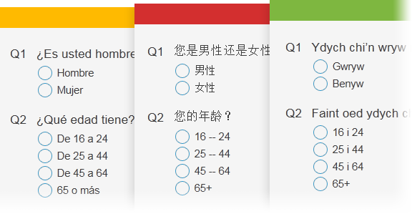
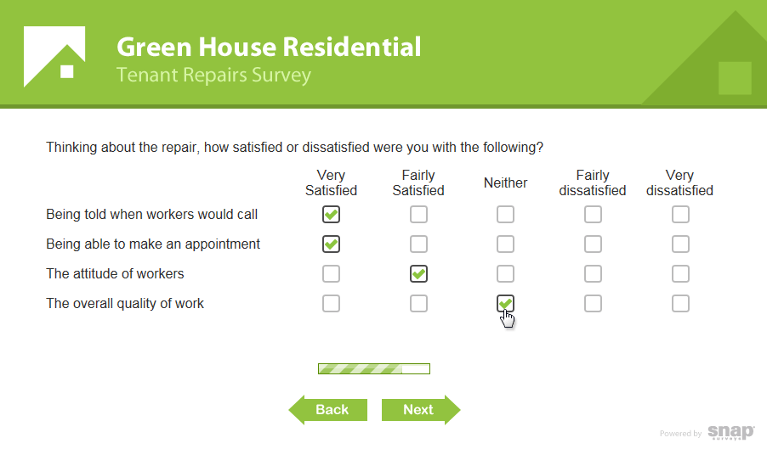
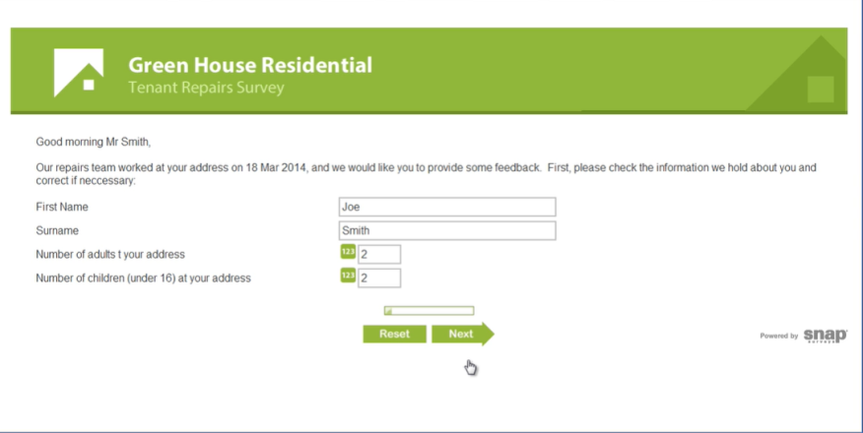
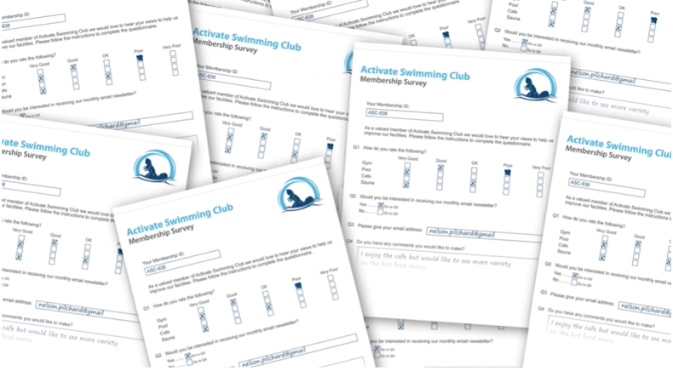
Snap Software
Surveys in any language
Design and Branding
Two-way database links
Multi-Format Surveys
Offline Data Collection
Paper Survey Scanning

Slide 4
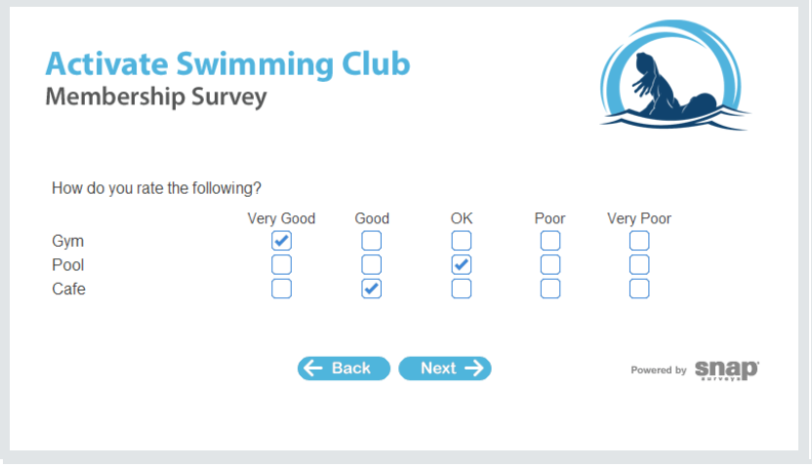
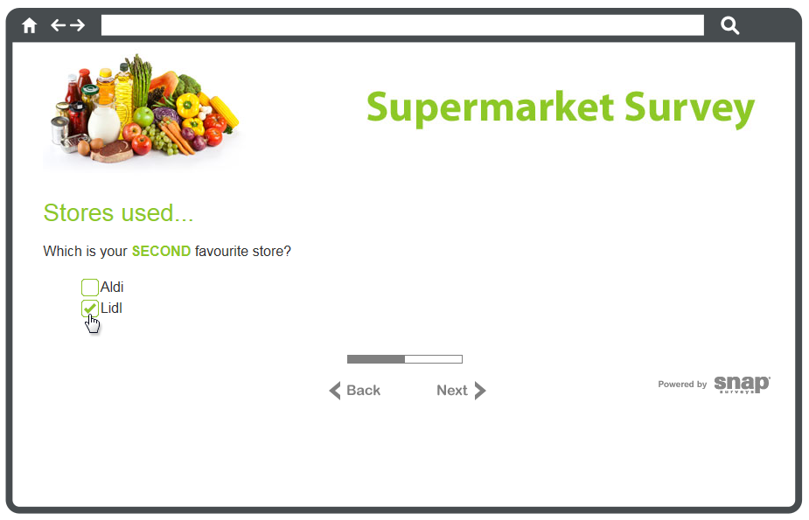
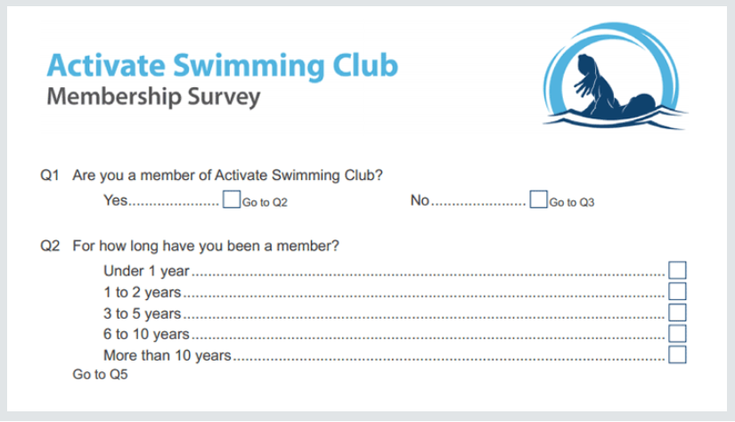
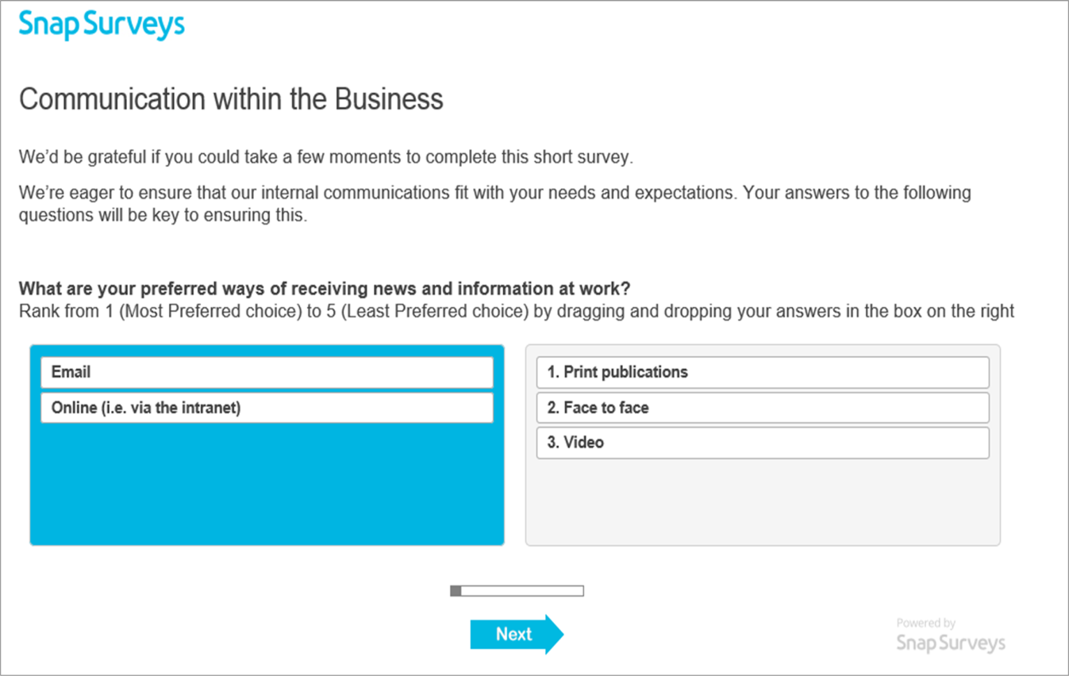
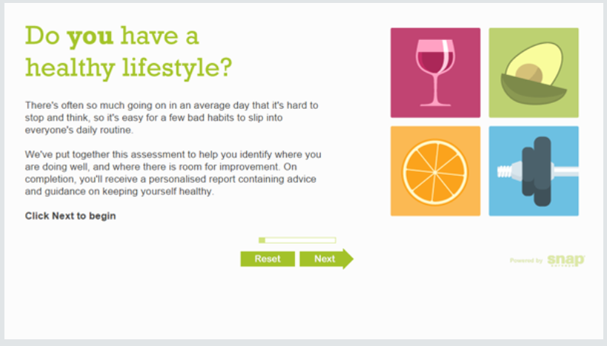
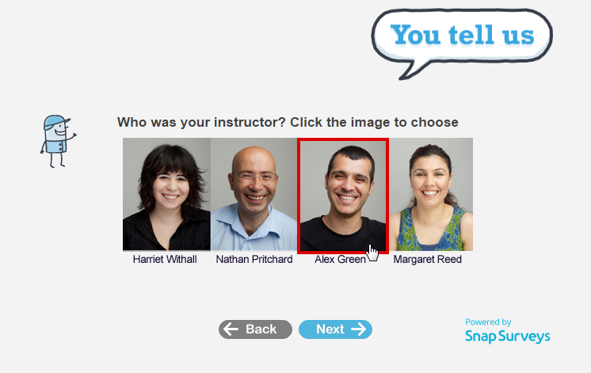
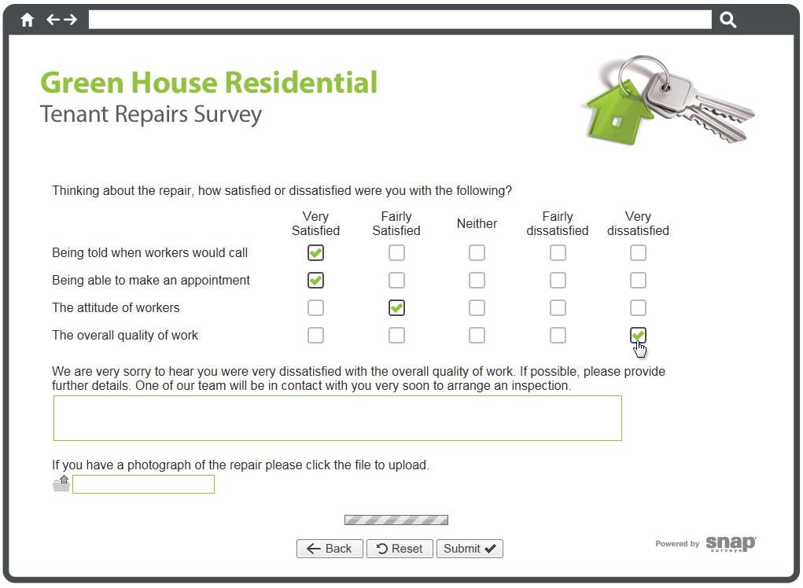
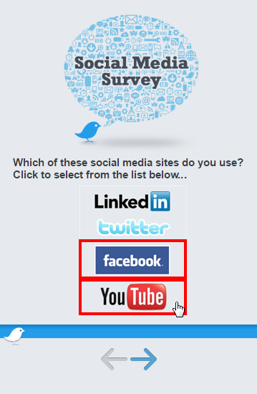
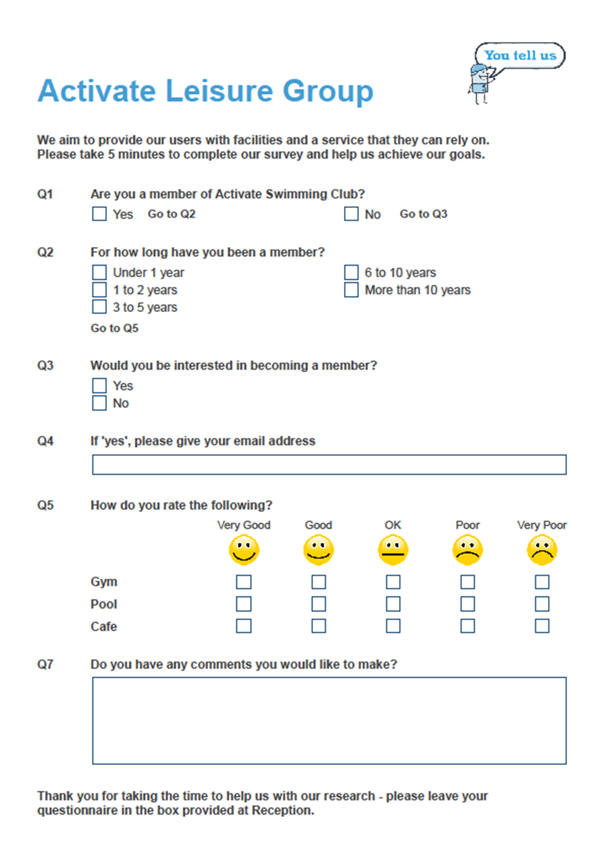
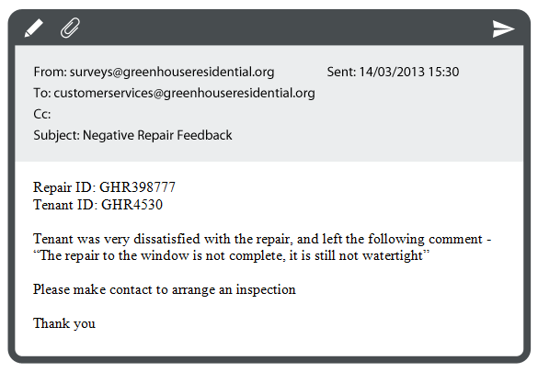
Snap Has…
Branded Questions
Dynamic Questions
Interactive Questions
Responsive Questions
Drag & Drop Ranking
Online Surveys
Paper Surveys
Mobile Surveys

Slide 5
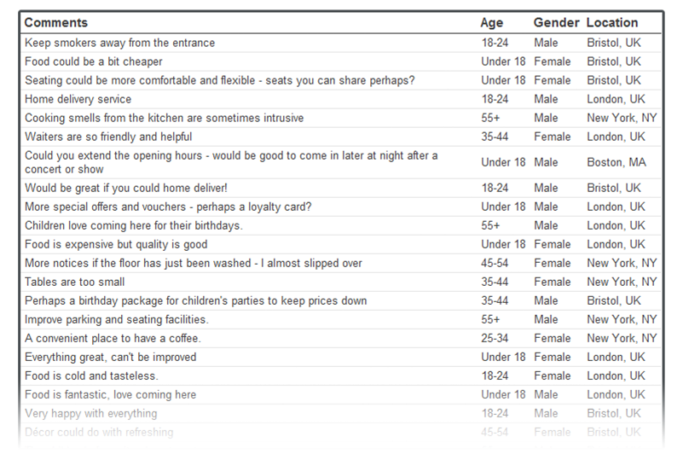
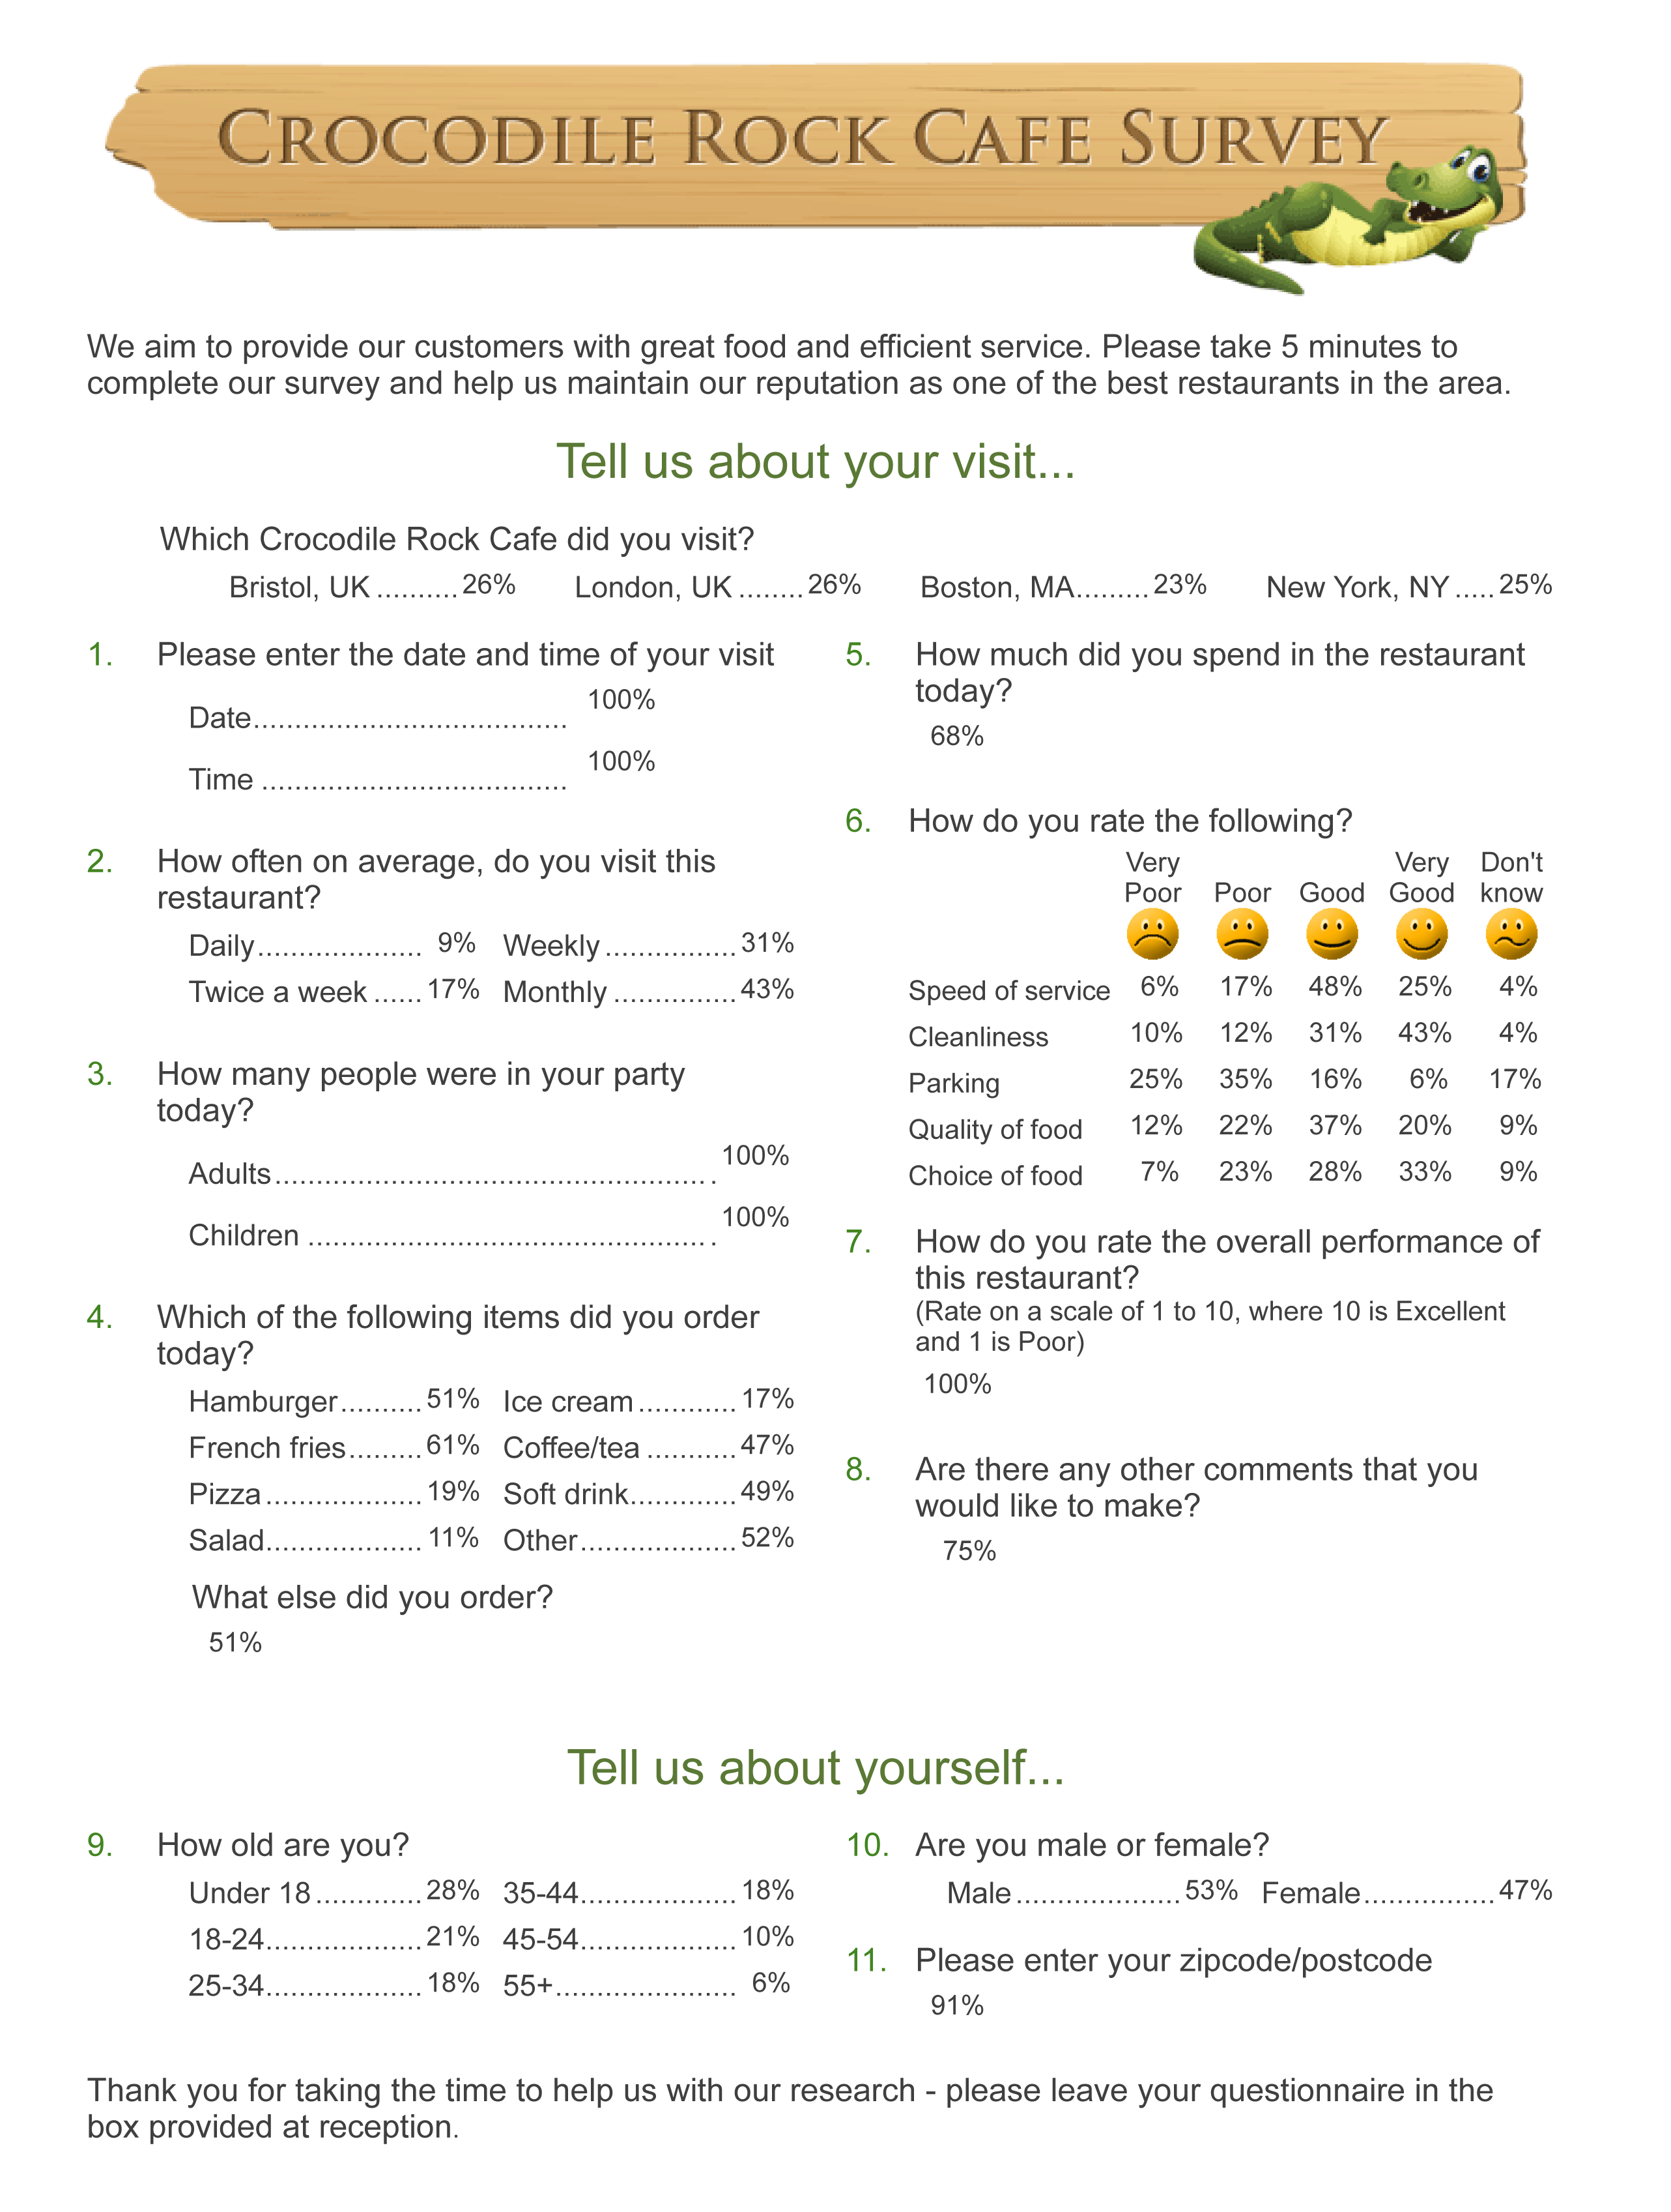
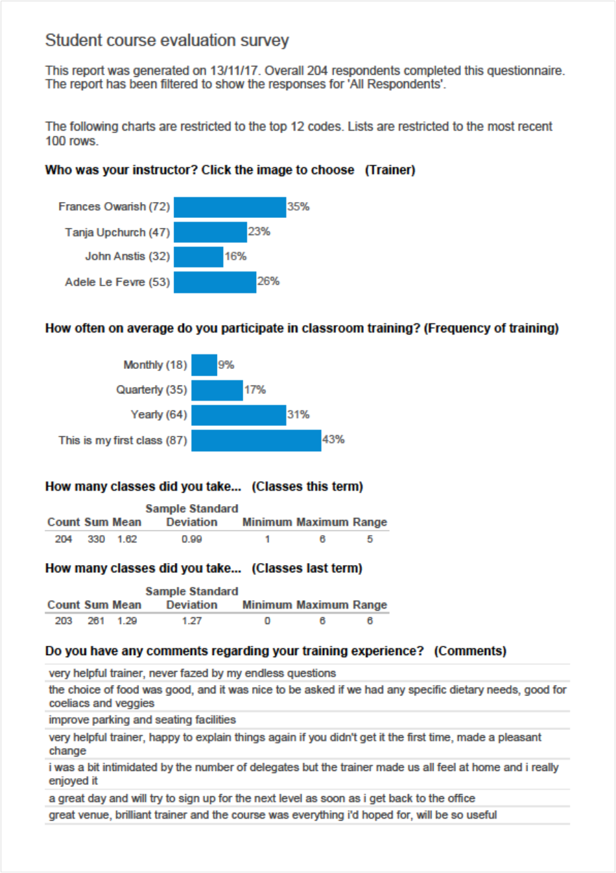
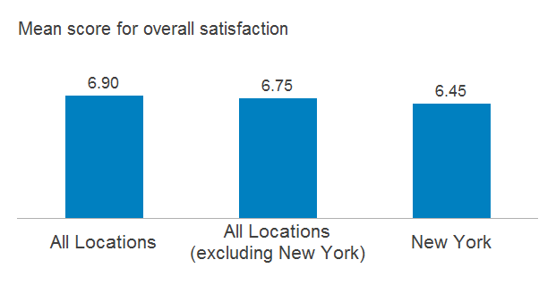
Snap - Powerful Analysis Tools
Charts
Cross Tabulations
Analysis Tools
Summary Report
Summary Counts
Smart Reporting

Slide 6

Nathan Pritchard
Training Consultant

Slide 7
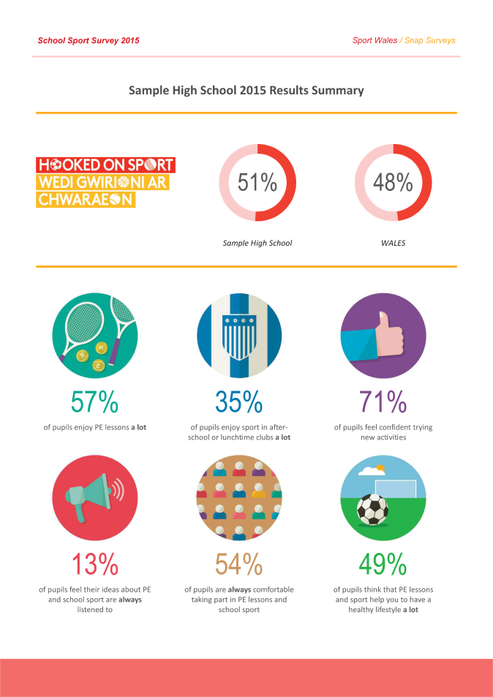
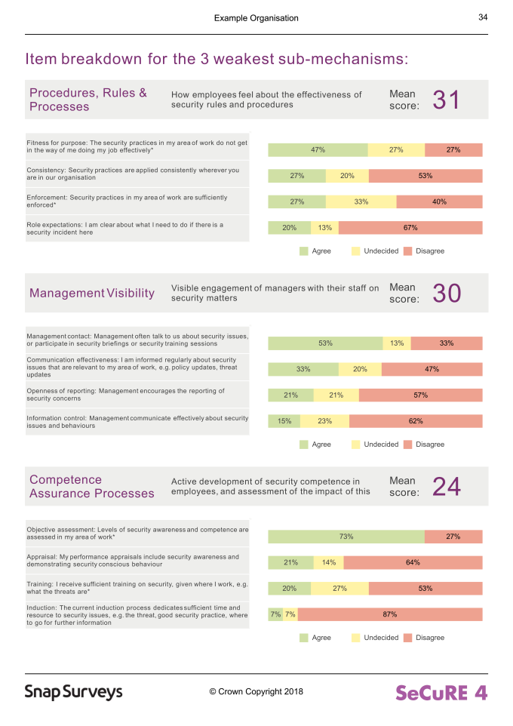
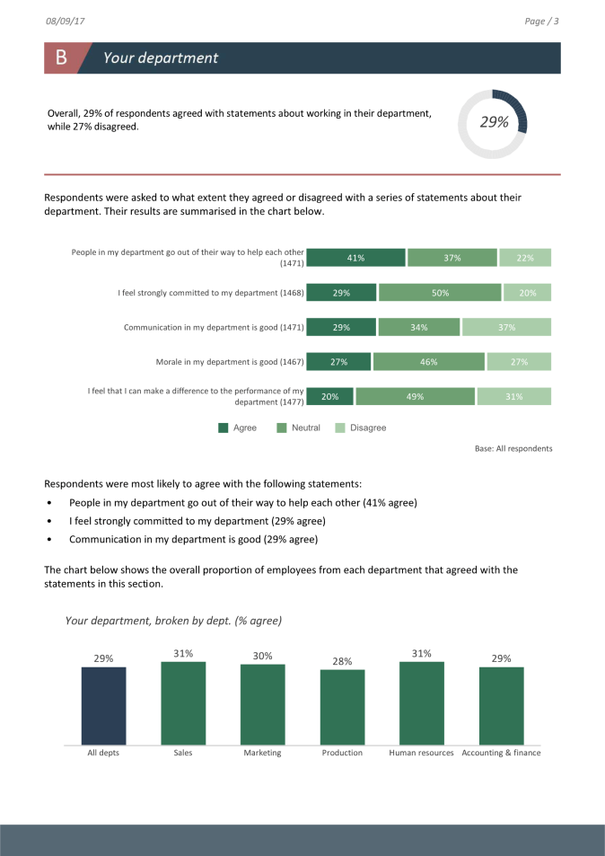
Smart Reporting

Slide 8
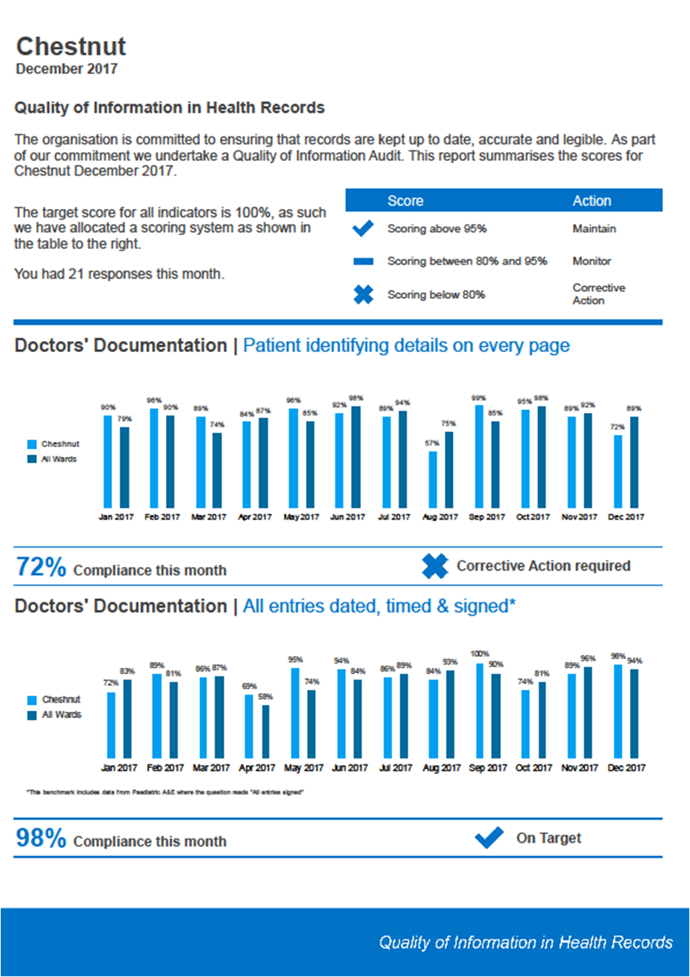
Smart Reporting
Traditional written reports are a one-off snapshot of survey results.
With Smart Reporting, you can quickly produce multiple and complex report variations that are updated in real time.
Cell Referencing
- Add dynamic commentary to your tables and charts
Static Benchmarking
- Compare (Benchmark) your data against a known dataset
Global Filters
- Filter multiple analyses at the click of a button
Dynamic Benchmarking
- Compare (Benchmark) your data with a dynamically changing dataset
o table or chart

Slide 9
Smart Reporting
Traditional written reports are a one-off snapshot of survey results.
With Smart Reporting, you can quickly produce multiple and complex report variations that are updated in real time.
Use Context to run Reports
- Mass produce personalised reports
Conditional Inclusion
- Specify when areas of a report will display
Reusable Reports
- Become more efficient in your report creation

Slide 10
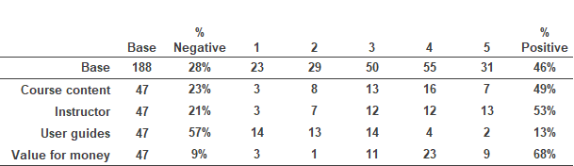
Cell referencing
Pick out key elements of data from a table or chart
49% of pupils who rated the Course Content gave a response of 4 or 5 with 23% choosing one of the negative options. This represents a difference of 26%.

Slide 11
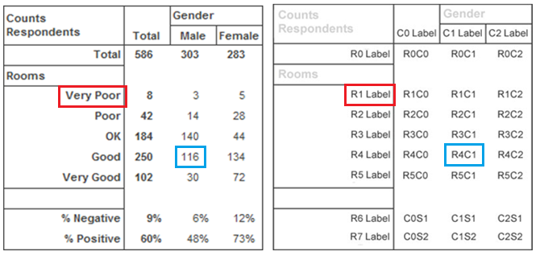
Cell referencing
Pick out key elements of data from a table or chart

Slide 12
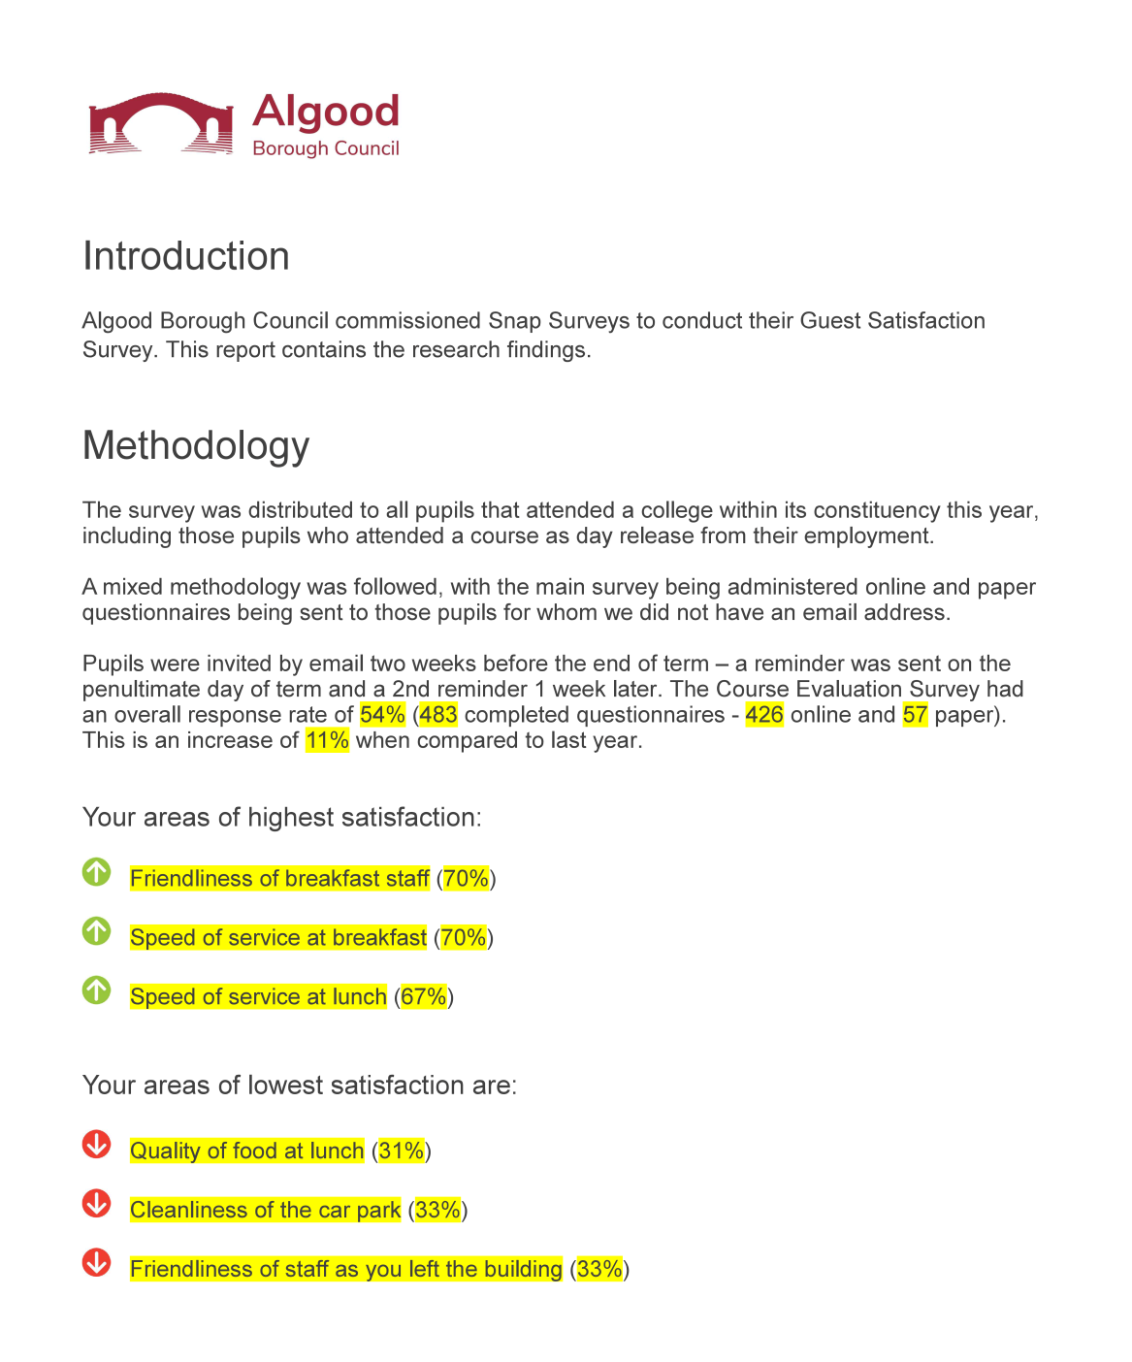
Cell referencing
Introduce cell referencing throughout your report to give it that personalised look and feel

Slide 13
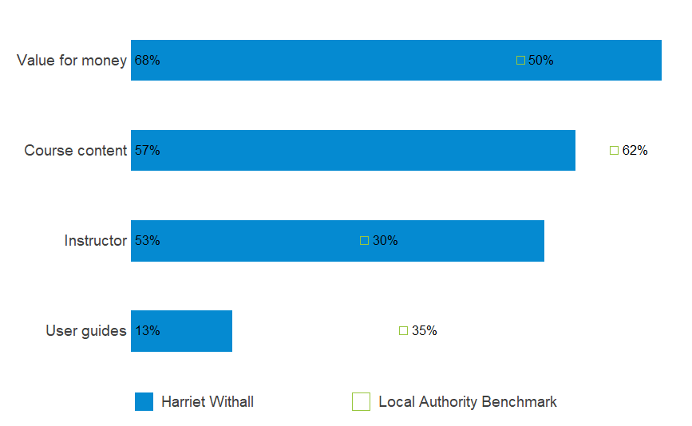
Static Benchmarking
Compare your data against a known dataset

Slide 14

Global Filters (Context)
Filter multiple analyses and reports at the click of a button

Slide 15
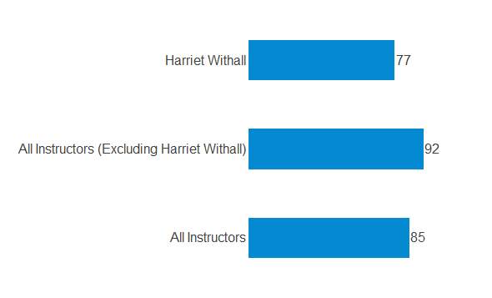
Dynamic Benchmarking
Compare your data with a dynamically changing dataset

Slide 16
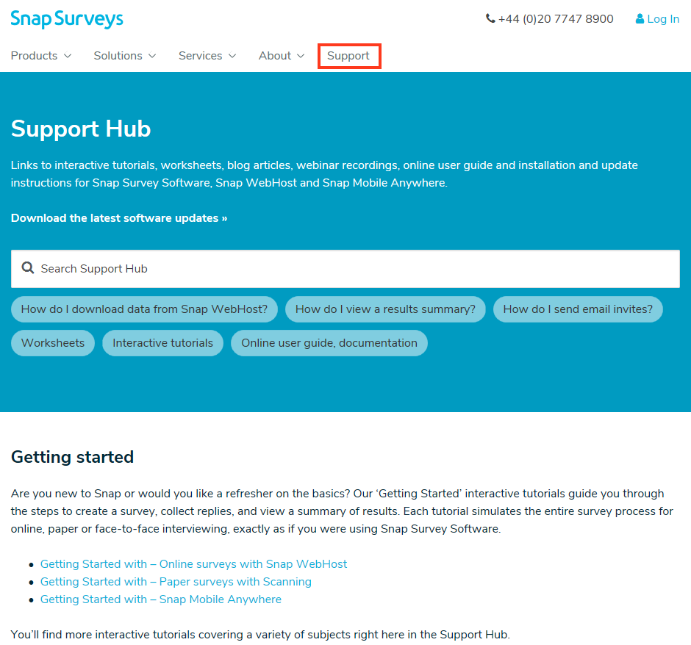

Slide 17
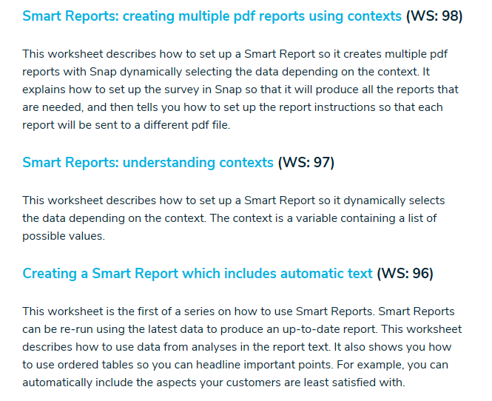

Slide 18
Smart Reports in Snap
Presented by:
Nathan Pritchard
Wednesday 27th May 2020
KwikLearn
Series
Q&A
nikki.sunga@mrdcsoftware.com

