Slide 1
MRDC SOFTWARE WEEK 2019
Data Analysis
Presented by: Phil Hearn
Tuesday 5th November 2019

Slide 2
PURPOSE OF THIS
SOFTWARE WEEK/
THIS WEBINAR
To look at solutions that resolve DATA ANALYSIS problems
Focus on areas where software can make a difference
Not a sales presentation
Goals
  Open up a discussion
  Offer ideas on how you can improve what you do
  Improve the standard of software in market research

Slide 3
DATA ANALYSIS TYPES COVERED IN THIS WEBINAR
Included
Cross-tabulations
Summary results
Basic charts
Extracting data for other analysis
Automation
Tracking studies
Not included
Reports
Dashboards

Slide 4
PROBLEMS ENCOUNTERED
Problems
Low incidence of problems in our survey
Processing time for big surveys
The time specifications take
Finding the right tools
Clients demanding more statistics
Real-time analysis not available
`Consider these issues
Who should produce analyses?
What’s the best software type to use?
Utilise the skills you have
Productivity matters more than many realise
Powerful software vs easy-to-use software
Notes:
Similar to The Data collection template although these do not need to be colour coded but please could you make them look nicer

Slide 5
THE BIG
DP ISSUES
  Senior management do not always understand the impact of DP decisions
  Badly handled data processing can take 10 times longer than it needs to
  Skills and training are not considered enough
  The “working backwards” technique can improve productivity
    What’s the final goal
    How do we get to that goal?
    What barriers are there to this being a smooth operation?
    Let’s look at an example!

Slide 6

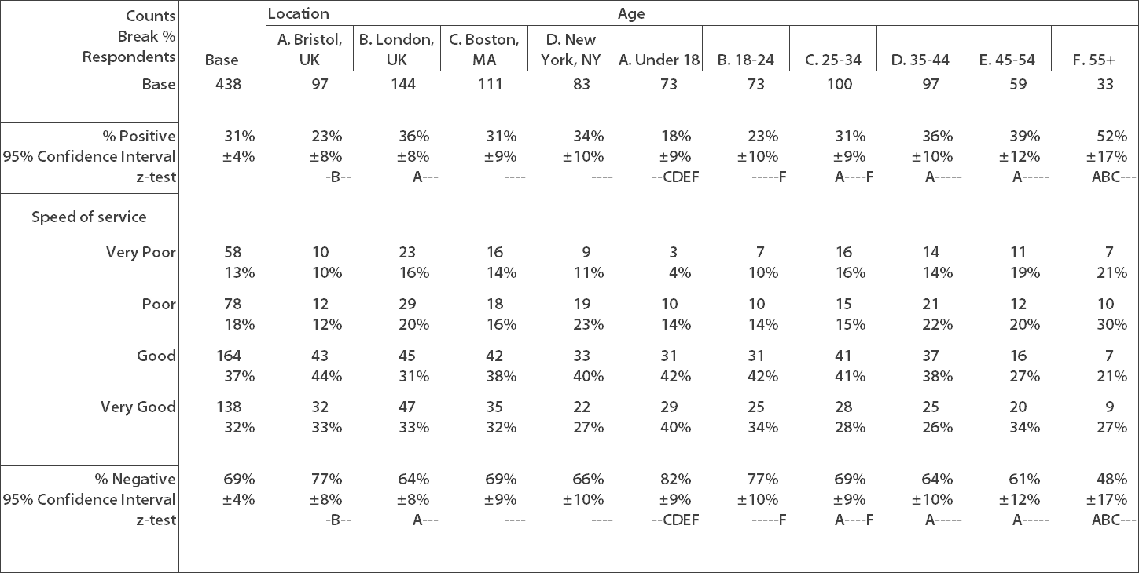




Notes:
Please feel free to update the colours/ themes etc these are just the animations we would like

Slide 7


THINK BACKWARDS
Notes:
Please feel free to update the colours/ themes etc these are just the animations we would like

Slide 8
WHO SHOULD
PRODUCE ANALYSES
  You may have a system in place, but does it really make sense?
  The choices
    Researchers do everything
    Specialist DP staff do everything
    A mix of DP staff and researchers
  Further choices where there is a DP team
    Highly skilled DP do all DP (usually over-skilled)
    Less skilled DP do all DP (usually under-skilled)
    Projects are shared between skilled and less skilled workers
  Will training make a difference?
  Is it worth considering buying expertise?

Slide 9
PRODUCTIVITY
MATTERS
  Yes, obviously but…..
  The difference between a skilled worker vs. an inadequately skilled worker may be 10 times (or more!)
  The difference between someone using the right software and right techniques vs. inadequate software or the wrong techniques may be 10 times (or more!)
  This is seldom considered!!!
  Do a cost evaluation
  Let’s take an example

Slide 10
Example 1: Sizeable simple tabulation project
Skilled staff | 2 days | $200 / day | $400
Less skilled staff | 3 days | $150 / day | $450
Right software | 2 days | $200 / day | $400
Inefficient software | 3 days | $150 / day | $450
Example 2: Complex tracking study
Skilled staff | 5 days per month | $200/day | $12000 / year
Less skilled staff | 10 days per month | $150/day | $18000/year
Right software | 3 days per month | $200/day | $7200 / year
Inefficient software | 10 days per month | $150/day | $18000 / year
Notes:
Please just colour this in line with the rest of the theme we will be adding a spreadsheet on top once it is done

Slide 11
SCRIPTING LANGUAGES vs
GUI SOFTWARE
  Investment in training needed for scripting languages
  Are the users using the software most days or from time to time?
  Do you have some types of surveys where a scripting language will make a difference?
    Tracking studies
    Repetitive surveys
    Complex analyses
  Long surveys don’t mean you need a scripting language
  Less mistakes when you use a GUI interface

Slide 12
MRDC SOFTWARE WEEK 2019
Data Analysis
Presented by: Phil Hearn
Tuesday 5th November 2019
Wednesday: Reporting
Thursday: Online communities & social media
Friday: Experts Panel Discussion

Slide 13
MRDC SOFTWARE WEEK 2019
http://bit.ly/mrdc-sw19
Data Analysis
Presented by: Phil Hearn
Tuesday 5th November 2019
Wednesday: Reporting
Thursday: Online communities & social media
Friday: Experts Panel Discussion

