Slide 1
Online communities - what activities are there
Presented by Phil Hearn & Nikki Sunga
Wednesday 15th April 2020
KwikLearn
Series

Slide 2
ONLINE COMMUNITIES
WHAT ACTIVITIES ARE THERE?
15th APRIL 2020 BY NIKKI SUNGA

Slide 3
ENGAGE WITH CUSTOMERS
CO- CREATE

Slide 4
AWARD WINNING DIY ONLINE COMMUNITIES PLATFORM

Slide 5
ANY COUNTRY
AND ON ANY DEVICE
I like the packaging
J’ame I’emballage
Ich mag die Verpackung
ผมชอบบรรจุภัณฑ์

Slide 6
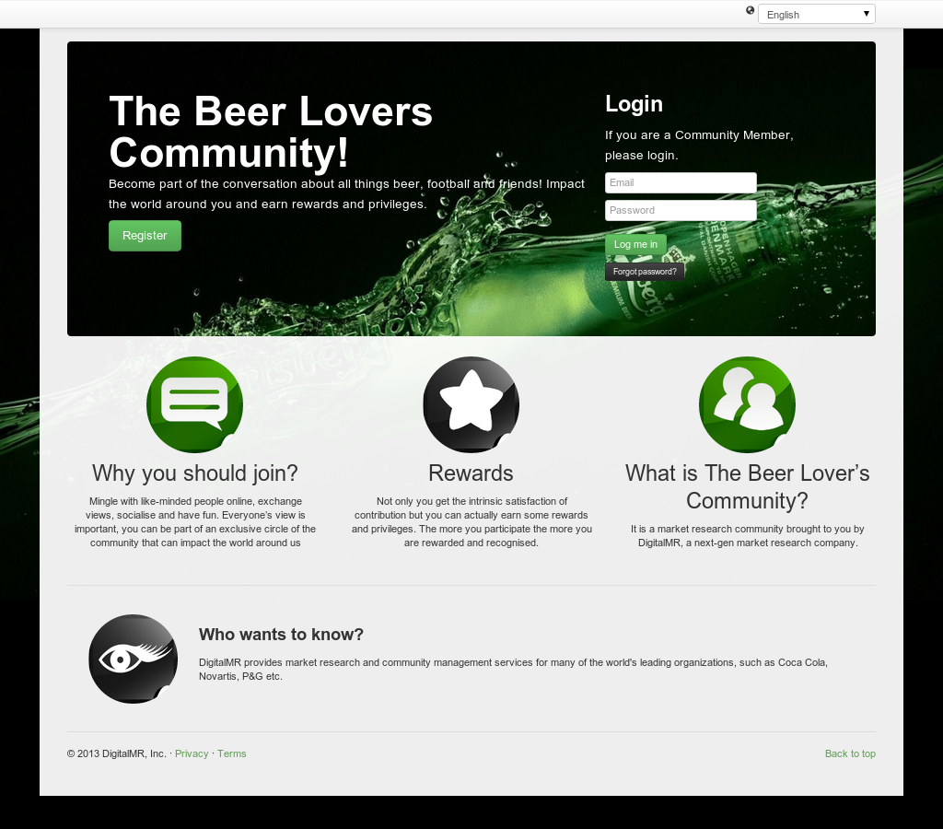
CUSTOMISE YOUR COMMUNITY TO MATCH YOUR
BRANDING

Slide 7
LONG TERM COMMUNITY – ESTABLISHMENT PROCESS
DEFINE SCOPE
RECRUIT
ENGAGE
RUN ACTIVITIES
REPLENISH & GROW

Slide 8
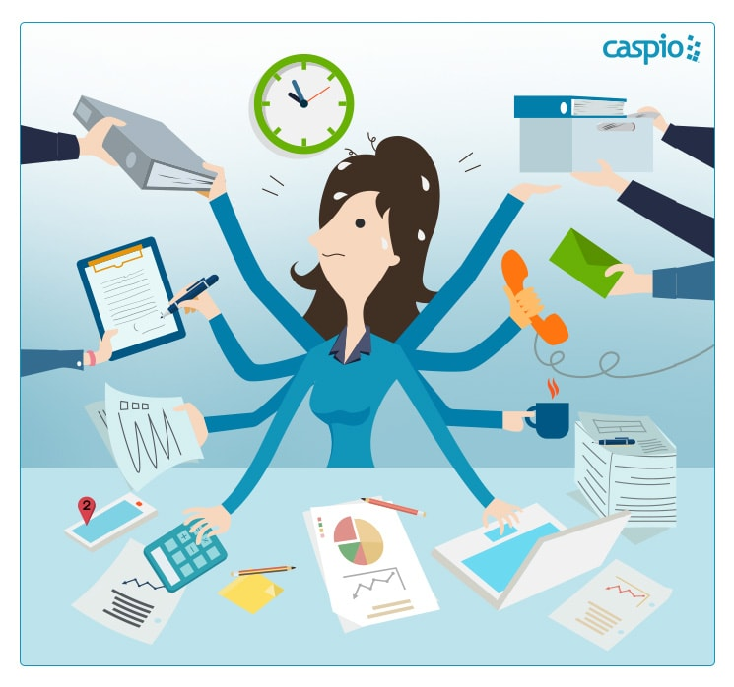
COMMUNITY ROLES
ADMIN
MEMBER
OBSERVER
MODERATOR

Slide 9
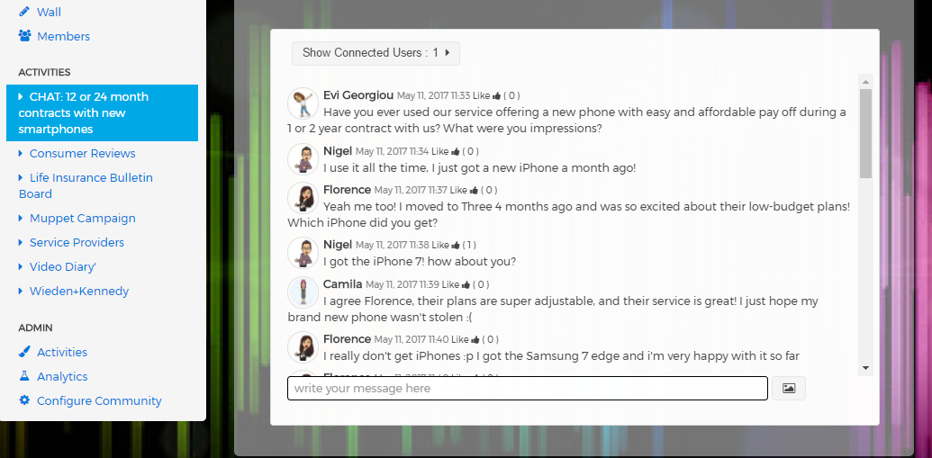
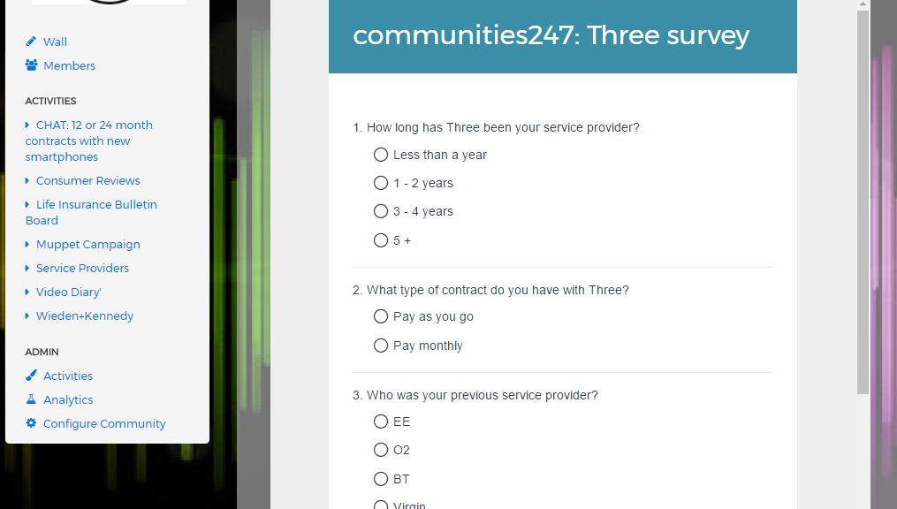
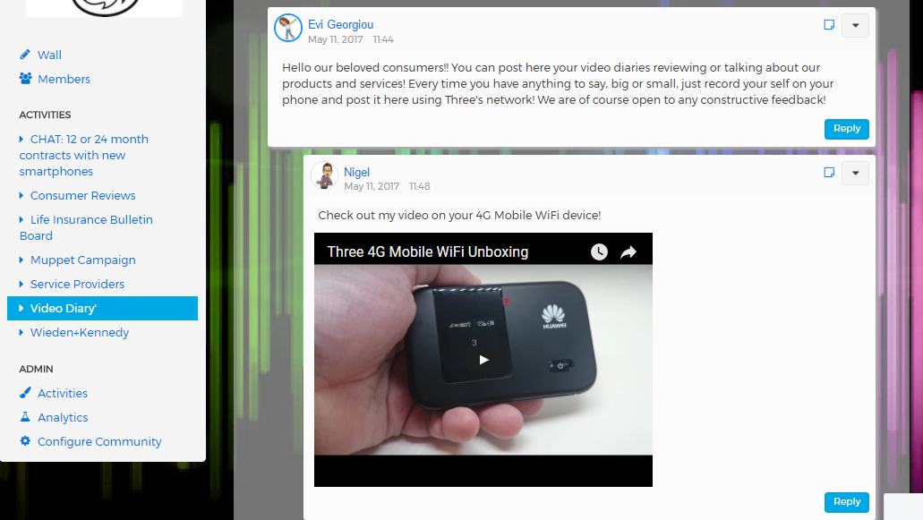
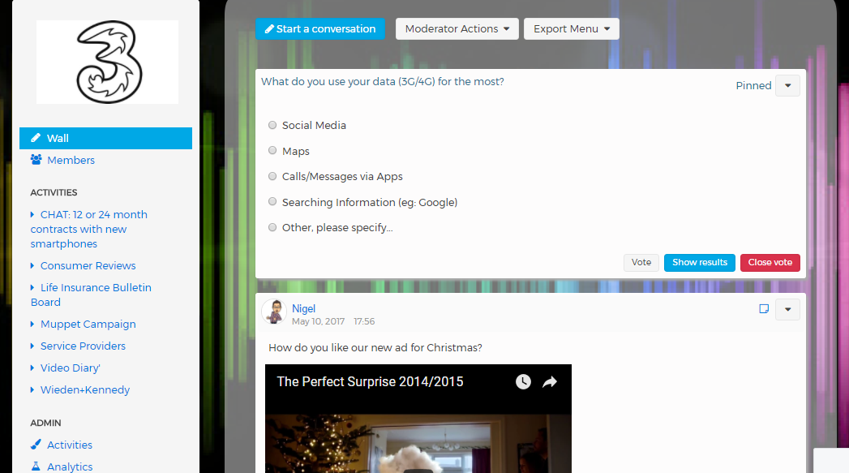
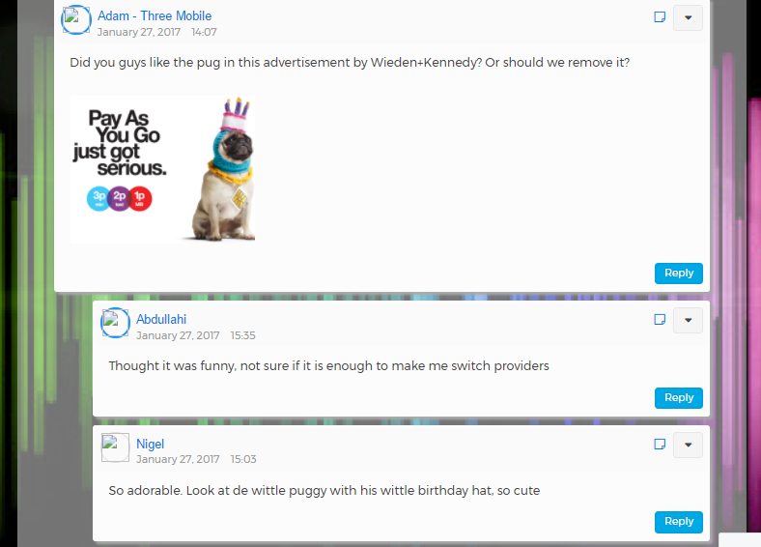
WHAT ACTIVITIES ARE THERE?
One to One Engagement
Wall Conversation & Polls
Wall Conversation & Polls
Inter-active Bulletin Board
Inter-active Bulletin Board
Chat Group
Chat Group
Photo and Video Diary
Photo and Video Diary
Inter-active Online Survey
Inter-active Online Survey

Slide 10
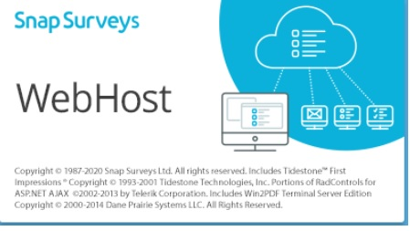
SNAP for online surveys

Slide 11
Create and fully customise your own community and run research activities for 28 days at no cost. Start your free trial.
20% DISCOUNT TILL END OF MAY
nikki.sunga@mrdcsoftware.com
Notes:
You can use this slide as your opening or closing slide. Should you choose to use it as a closing, make sure you review the main points of your presentation. One creative way to do that is by adding animations to the various graphics on a slide. This slide has 4 different graphics, and, when you view the slideshow, you will see that you can click to reveal the next graphic. Similarly, as you review the main topics in your presentation, you may want each point to show up when you are addressing that topic.
Add animation to images and graphics:
Select your image or graphic.
Click on the Animations tab.
Choose from the options. The animation for this slide is “Split”. The drop-down menu in the Animation section gives even more animations you can use.
If you have multiple graphics or images, you will see a number appear next to it that notes the order of the animations.
Note: You will want to choose the animations carefully. You do not want to make your audience dizzy from your presentation.

